Slide 1
A Multi-factor Security Protocol for
Wireless Payment-Secure Web
Authentication using Mobile Devices

Slide 2
Abstract
The Cell phones have revolutionized the way we live. Cellular phones and PDA's have largely grown in popularity and as a result users have started online banking, purchasing of internet-based products and other online services. Previous web access authentication systems have used either the Internet or the wireless Mobile channel independently to authenticate the identity of remote user.
Accessing today's web-based services always requires a username and password to authenticate the user identity. This is a significant vulnerability since the password can be hacked by the man in the middle attack and later used for making illegal access to the user’s account. Our goal is to create an authentication system that is both secure and highly usable based on multifactor authentication approach. It uses a novel approach to create an authentication system based on TICs (Transaction Identification code) and SMS (Short Message Service) to enforce an extra security level with the traditional Login/password system.
We have also used an encryption/decryption technique which is based on symmetric key and an iterated block cipher concept. This concept has been used to keep TICs as secret code on cell phones/PDAs and is also used to initiate secure web transaction using cell phones/PDAs. Finally we extend the system for two way authentication which authenticates both parties (user and e- service provider). A detailed threat analysis demonstrates that the proposed system is secure against various types of internet attacks like phishing, man-in-the-middle, viruses etc.

Slide 3
Objective
The main objective of the present work is to provide a highly secure wireless environment for financial web transactions that is simple to use and deploy, that does not require any change in existing wireless networks or protocol.
This Protocol for Wireless Payment is used to achieve secure web transaction using cell phones / PDAs. The system is based on Multi-factor Authentication concept to provide secure wireless environment to the users to increase faith of the users in online financial web transactions using mobile devices

Slide 4
Introduction
As computing becomes pervasive, people increasingly rely their business over the Internet by using
e-commerce. Now, the Internet is a preferred source to access online eservices such as e-commerce,
e-voting, e-banking, e-government, etc.
Online applications require a strong security feature to protect user confidential data. Security is a major
issue in internet based online payment system. There are various internet threats which affect the
security system of internet and increase risk for electronic transaction. Most of the authentication system
relies on passwords, personal identification numbers and keys to access their personal account information
This type of authentication system can not verify or authenticate the identity of the users who he or she claims
to be Accessing today's web-based services always requires a username and password to authenticate the user
identity. This is a significant vulnerability since the password can be hacked by the man in the middle attack
and later used for making illegal access to the user’s account.

Slide 5
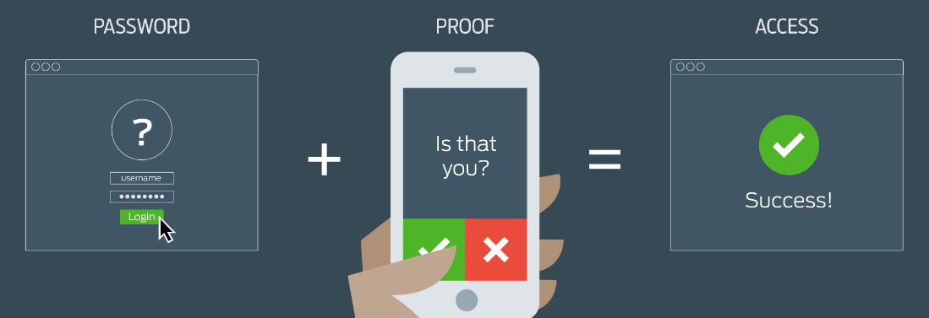
When it comes to the communication of sensitive data security has always been an important topic. With hardware advances allowing users the advantage of accessibility used in mobile devices, individuals are now spending more and more time on these devices. Additionally, with the viral popularity of social media applications and single sign-on, users do not always take as many precautions as needed with their information. Multi-factor authentication creates more and varied walls to block out the wrong people from seeing your information

Slide 6
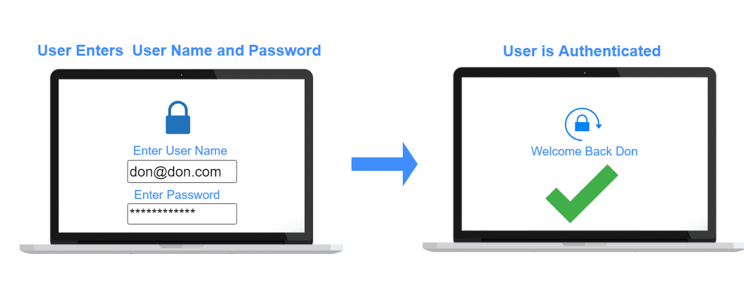
What is Single-factor Authentication (SFA):
Single-factor authentication is the simplest form of authentication methods. With SFA, a person
matches one credential to verify himself or herself online. The most popular example of this would be
a password (credential) to a username. Most verification today uses this type of authentication
method.

Slide 7
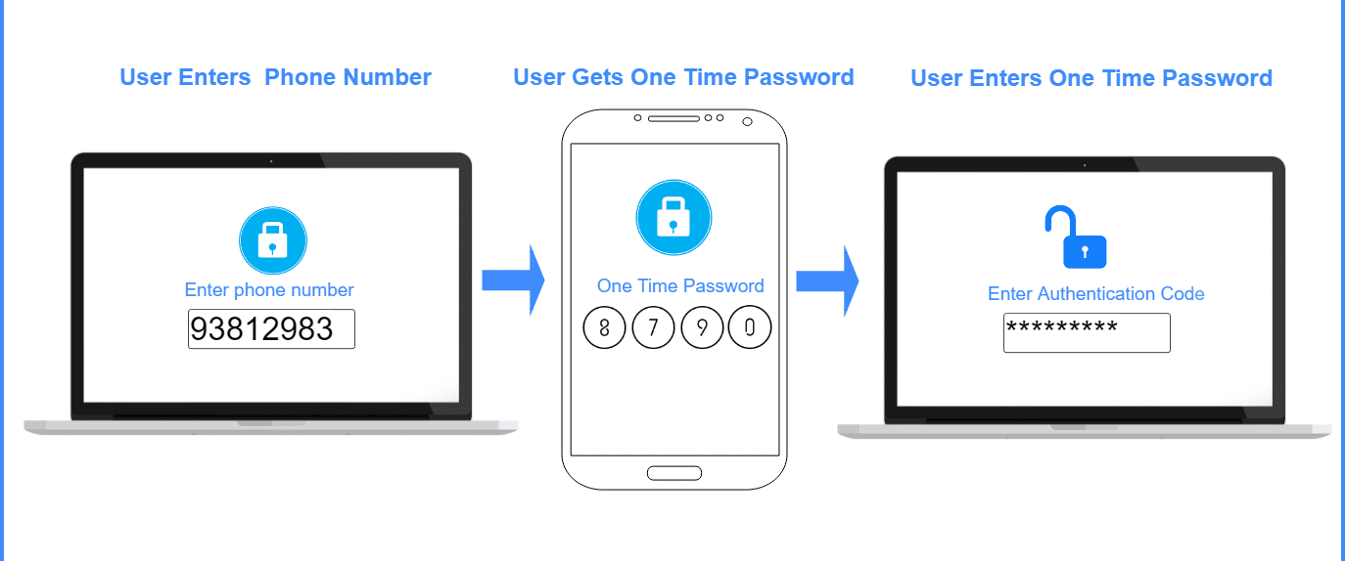
What is Two-factor Authentication (2FA):
Two-factor authentication uses the same password/username combination, but with the addition of being
asked to verify who a person is by using something only he or she owns, such as a mobile device. Putting it
simply: it uses two factors to confirm an identity

Slide 8
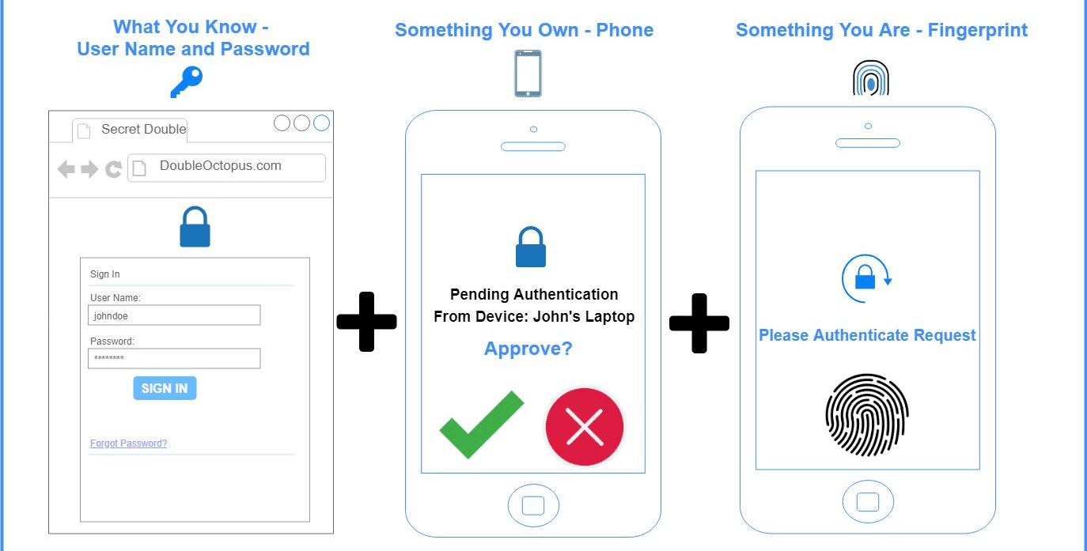
What is Multi-factor Authentication (MFA):
Multi-factor Authentication uses a combination of the following factors: something you know,
something you have and something you are. 2FA is a subset of MFA

Slide 9
TIC Authentication: TIC (Transaction Identification Code) Authentication is the technique which is used to identify both the user and the ongoing transaction. TIC code certifies that the current transaction has been initiated by the right person and it is a valid user who is trying to access his/her account TIC codes are: Issued by the Bank or Financial institution to its customer. 8 bit or 16 bit Pseudo randomly generated code which is assigned to the customers. May be complicated digit sequence or combination of numeric or alpha numeric characters. One TIC code is used only once, i.e. a unique TIC is used for each transaction.

Slide 10
Division of Modules
Module 1
Module 2
Module 3
Module 4
Introduction to Factors of Authentication and Existing System.
Specification , Transaction flow of the Protocol & Cryptography
System analysis with various Internet threats & Technology .
System implementation & simulation results

Slide 11
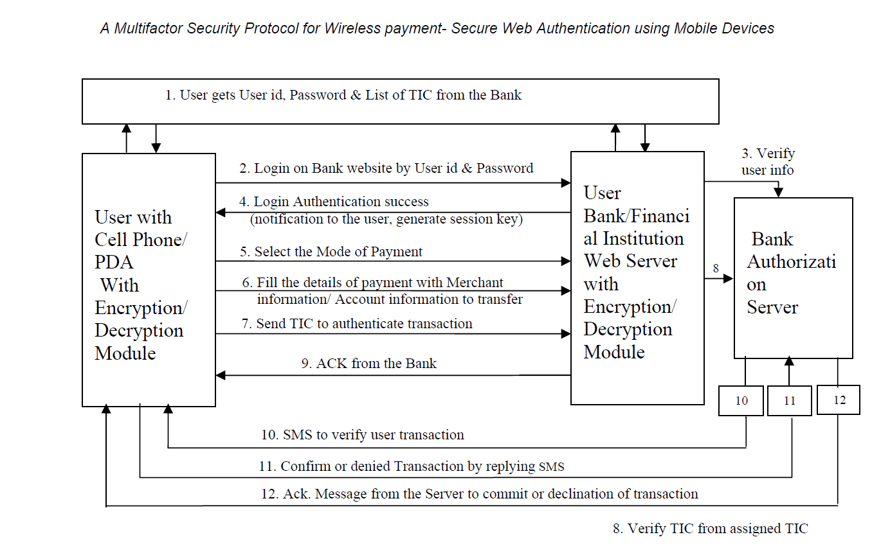
Proposed Protocol

Slide 12
Proposed Protocol 1. The first authentication of the user by the bank authentication server i.e. the basic login and password based user authentication. 2. Two way authentication i.e. authentication of the merchant / vendor / service provider. 3. The second authentication of the user and the transaction using TIC. 4. The final authentication and confirmation of transaction by the user, using SMS

Slide 13
TIC Authentication: After authenticating the user using username/password, the web authentication server demands a TIC code from the user. Now Cell phone/ PDA user will insert a one time TIC code to uniquely identify their transaction and prove his/her authentication to the webauthentication server. TIC code would be selected from the stored list of TICs which were issued by authorized financial institution and uniquely assigned to its customers.

Slide 14
Conclusion
The current authentication technique for online payment system is not very secure to protect
user from identity theft, as a the result any attacker gain the access on confidential
information of user like credit card number or account password and make illegal transfer of
fund which will be charged to the valid user’s account
In the presented protocol we have focused on an application-layer security solution for
wireless payment system to implement an end-to-end authentication and data
confidentiality between wireless client and java based secure server. The presented work
proposed a new protocol for web user authentication based on multifactor authentication
approach which is completely secure and easy to implement

Slide 15
Future Work
Future work will focus on developing a new and efficient way for TIC codes generation
at the financial institutions. TIC code installation on the user’s cell phone must also be an
easy task to avoid repeated visits by the customers to the bank or financial institution.
Server side TIC maintenance, management mechanism and distribution to satisfy the
demand from a large number of users are also part of future work.

Slide 16
References
https://www.cmu.edu/iso/news/mfa-article.html#:~:text=Multi%2Dfactor%20authentication%20should%20be,protect%20highly%20sensitive%20personal%20information
https://ieeexplore.ieee.org/document/8701960
https://ieeexplore.ieee.org/document/8356384
https://ieeexplore.ieee.org/document/5069395
https://ieeexplore.ieee.org/stamp/stamp.jsp?tp=&arnumber=8701353
https://patentimages.storage.googleapis.com/72/48/2b/771c690320fa7b/US20050143051A1.pdf
https://www.tifr.res.in/~sanyal/papers/Multifactor%20Secure%20Authentication.pdf

Slide 17
https://computerresearch.org/index.php/computer/article/view/272/272
https://patentimages.storage.googleapis.com/a3/05/ed/e476c9ce65dc6e/US20130124364A1.pdf
https://ieeexplore.ieee.org/document/8356383
https://ieeexplore.ieee.org/abstract/document/8255200
Adi W., Mabrouk A., Al-Qayedi A., Zahro A. , “Combined Web/Mobile
Authentication for Secure Web Access Control”, In Wireless communications and
Networking conference, IEEE Communications Society, Atlanta, GA USA,
volume 2, pp. 677- 681, March 2004.

Slide 18
Thank You! -Batch No-281

